Slide 1


Introduction to Filebeat
Mr. Iyanou Eraste AKANDE Elastic Certified Engineer Data Engineer at Synaptique Maghreb

Slide 2
Beats
Use Case
Auditbeat | Audit data
Filebeat | Log files and journal
Functionbeat | Cloud data
Heartbeat | Availability of servers and services
Metricbeat | Metrics and statistics of instances
Packetbeat | Network Traffic
Winlogbeat | Window event logs

Slide 3
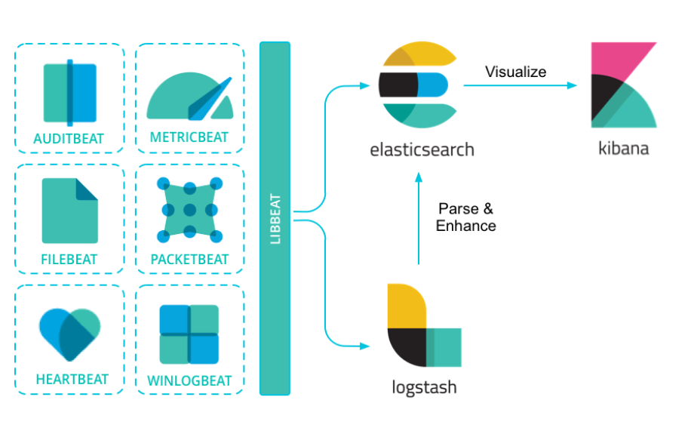
Beats
Architecture

Slide 4
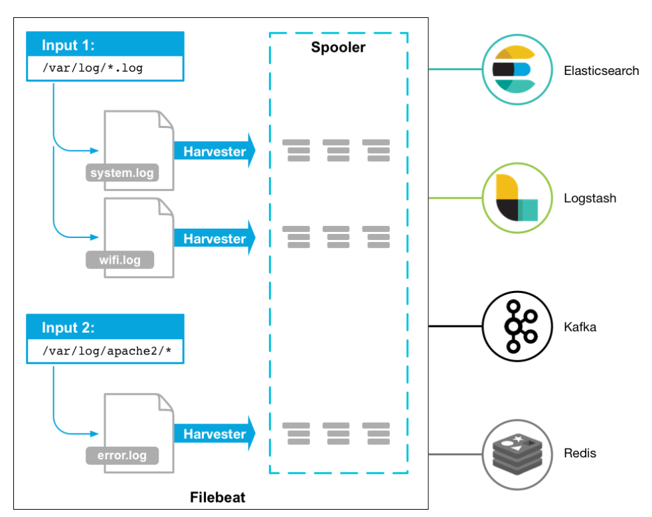
Filebeat
Architecture

Slide 5
Filebeat
Filebeat.yml >> Input
Input Types
AWS CloudWatch
AWS S3
Azure Event Hub
Azure Blob Storage
CEL
Cloud Foundry
CometD
Container
Entity Analytics
filestream
GCP Pub/Sub
HTTP Endpoint
HTTP JSON
journald
Kafka
Log (deprecated in 7.16.0, use filestream)
MQTT
NetFlow
Office 365 Management Activity API
Redis
Stdin
Syslog
TCP
UDP
Google Cloud Storage

Slide 6
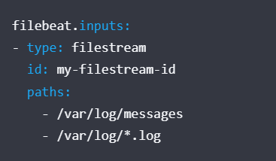
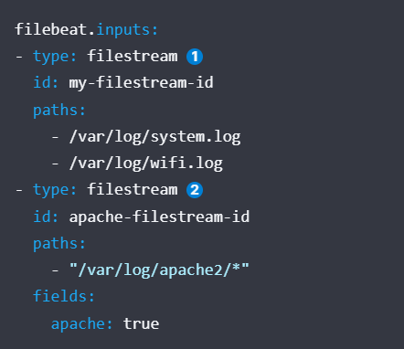
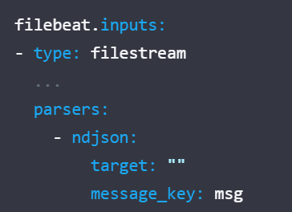
Filebeat
Filebeat.yml >> Input
Filestream Input
https://www.elastic.co/guide/en/beats/filebeat/current/filebeat-input-filestream.html

Slide 7
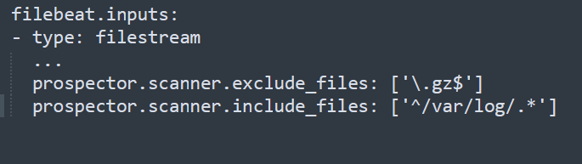
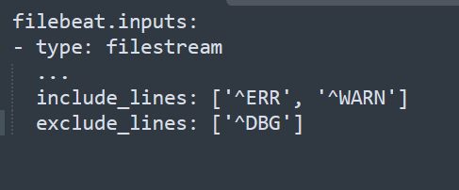
Filebeat
Filebeat.yml >> Input
Filestream Input
https://www.elastic.co/guide/en/beats/filebeat/current/filebeat-input-filestream.html

Slide 8
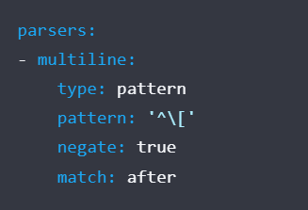
Filebeat
Filebeat.yml >> Input
Filestream Input
https://www.elastic.co/guide/en/beats/filebeat/current/multiline-examples.html
Problem
[beat-logstash-some-name-832-2015.11.28] IndexNotFoundException[no such index]
at org.elasticsearch.cluster.metadata.IndexNameExpressionResolver$WildcardExpressionResolver.resolve(IndexNameExpressionResolver.java:566)
at org.elasticsearch.cluster.metadata.IndexNameExpressionResolver.concreteIndices(IndexNameExpressionResolver.java:133)
at org.elasticsearch.cluster.metadata.IndexNameExpressionResolver.concreteIndices(IndexNameExpressionResolver.java:77)
at org.elasticsearch.action.admin.indices.delete.TransportDeleteIndexAction.checkBlock(TransportDeleteIndexAction.java:75)
Solution

Slide 9
Filebeat
Filebeat.yml >> Processors
Processors Types
https://www.elastic.co/guide/en/beats/filebeat/current/defining-processors.html
add_docker_metadata
add_fields
add_host_metadata
add_id
add_locale
append
convert
copy_fields
decode_base64_field
decode_csv_fields
decode_duration
decode_json_fields
decode_xml
decompress_gzip_field
dissect
drop_event
drop_fields
extract_array
fingerprint
include_fields
move-fields
rename
replace
script
timestamp
translate_sid

Slide 10
Filebeat
Filebeat.yml >> Processors
Processors Conditions
https://www.elastic.co/guide/en/beats/filebeat/current/defining-processors.html
equals
contains
regexp
range
network
has_fields
or
and
not

Slide 11
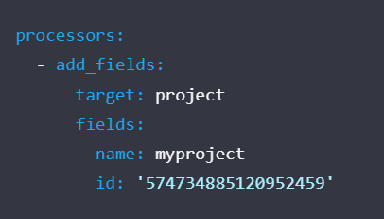
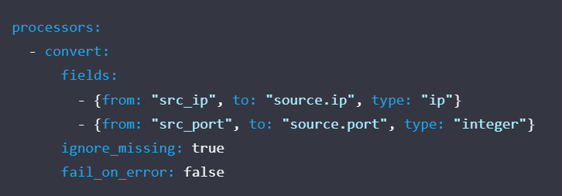
Filebeat
Filebeat.yml >> Processors
Examples

Slide 12
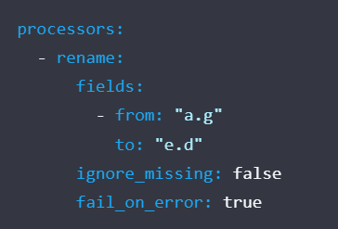
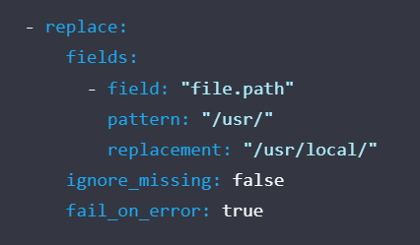
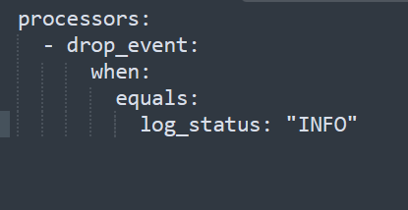
Filebeat
Filebeat.yml >> Processors
Examples

Slide 13
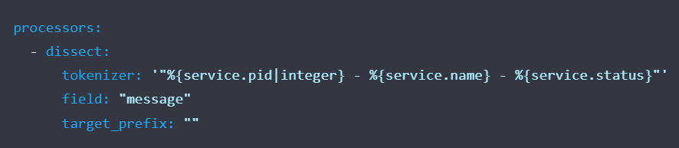
Filebeat
Filebeat.yml >> Processors
Examples
Problem
"321 - App01 - WebServer is starting"
"321 - App01 - WebServer is up and running"
"321 - App01 - WebServer is scaling 2 pods"
"789 - App02 - Database is will be restarted in 5 minutes"
"789 - App02 - Database is up and running"
"789 - App02 - Database is refreshing tables"
Solution

Slide 14
Filebeat
Filebeat.yml >> Output
Output Types
Elasticsearch Service
Elasticsearch
Logstash
Kafka
Redis
File
Console

Slide 15
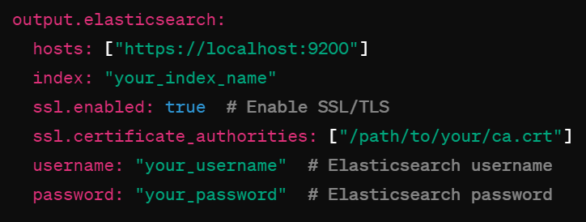
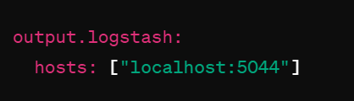
Filebeat
Filebeat.yml >> Output
Elasticsearch Output
Logstash Output

Slide 16
Filebeat
Modules
Modules List
https://www.elastic.co/guide/en/beats/filebeat/current/filebeat-modules.html
ActiveMQ module
Apache module
AWS module
Azure module
Cisco module
CoreDNS module
Elasticsearch module
F5 module
Fortinet module
Google Cloud module
Google Workspace module
IBM MQ module
Kafka module
Kibana module
Logstash module
Microsoft module
MongoDB module
MSSQL module
MySQL module
MySQL Enterprise module
Osquery module
PostgreSQL module
RabbitMQ module
Redis module
System module
ZooKeeper module
Zoom module
etc

Slide 17
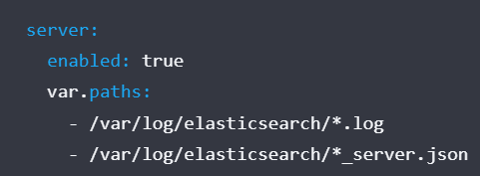
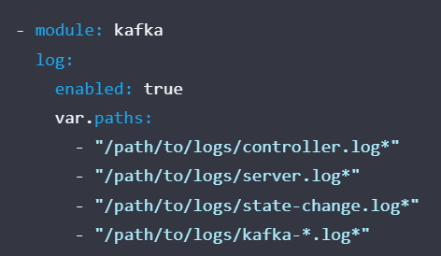
Filebeat
Modules
Configure modules.d file
Elasticsearch – elasticsearch.yml
Kafka – kafka.yml

Slide 18
Filebeat
Execution
cd filebeat_directory
filebeat modules enable module_name
filebeat setup –e
filebeat -e

Slide 19

Questions

Slide 20
Thank you
Mr. Iyanou Eraste AKANDE
eraste.akande@gmail.com

